Slide 1
Modeling of pintle-type injector internal fuel flow and in-cylinder spray behavior of SA HCCI z-engine
Victor Akimov, Andrey Kuleshov
Bauman Moscow State Technical University

Slide 2
SA HCCI realization in Z-engine
Due to specific in-cylinder temperature behaviour; massive internal EGR; fuel injection (by pintle-type injector) into a gas having low density the SA HCCI is possible!
Injection with pintle-type injector into a burnt gas when exhaust is near to terminating and intake has not started yet:
71 deg. before TDC. - p = 2,5 bar; T = 800 K; EGR=100%.
Injection pressure up to 1100 bar. SMD ~ 10 mm
Notes:
Эти доработки сделать для презентации ДИЗЕЛЬ-РК в части PCCI для Пежо

Slide 3
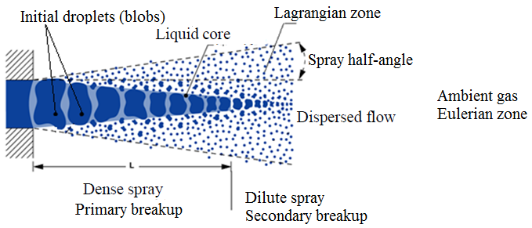
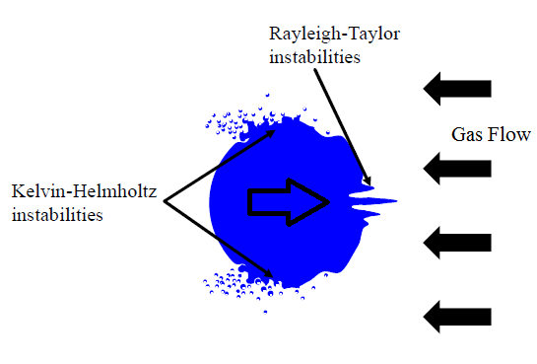
Simulation of in-cylinder spray behavior
Ansys Fluent discrete phase model
(Euler-Lagrangian approach)

Slide 4
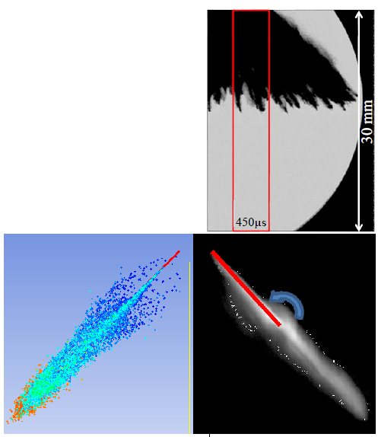
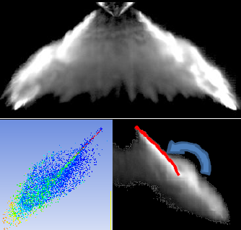
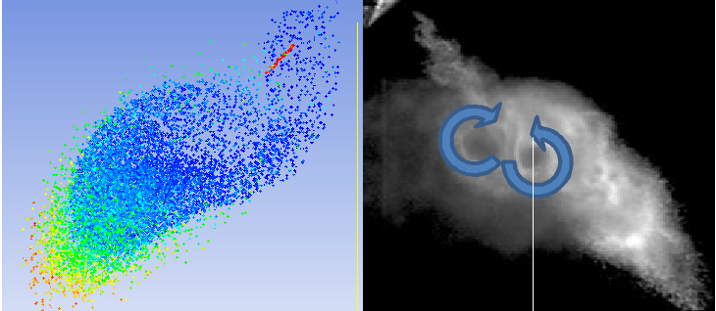
Experimental validation of non-evaporating injection
Experiment condition (Andreas Schmid et.al.)
Ambient gas density, kg/m³ | 2,2; 6,6
Ambient gas | Air (300K)
Fuel | Isooctane (300K)
Fuel density | 732,1
Injection pressure drop, Mpa | 12
Spray cone angle, deg | 90
Andreas Schmid experiment
6.6kg/m³, 350 ms after SOI
2.2kg/m³,
450 ms after SOI
6.6kg/m³ , 750 ms after SOI

Slide 5
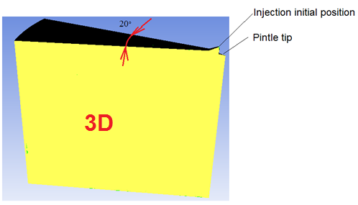
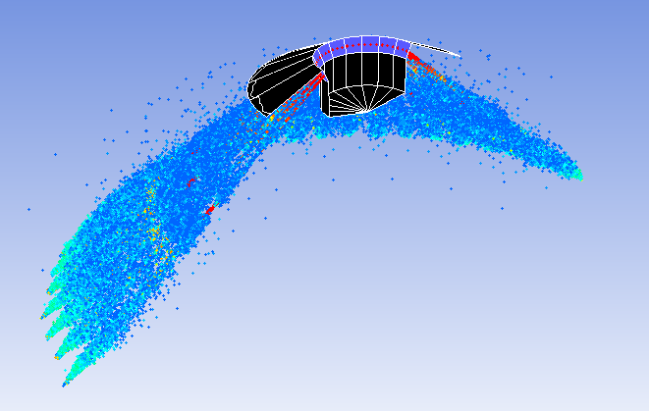
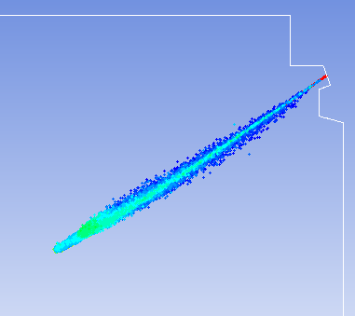
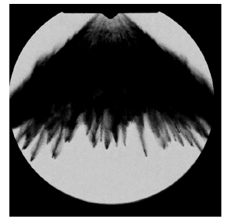
2D vs 3D
3D case visualization
2D case visualization
Experimental
shadowgraphy of similar injector
in similar condition
Definition | Computing time of 7,5 CAD injection duration, hours
2D | 12
3D | 110

Slide 6
Comparison of results of single droplet heating and evaporation obtained by different methods
Experiment condition (Sazhin et.al.)
Ambient gas | Air
Ambient pressure, MPa | 3
Ambient temperature, K | 880
Injected droplet material | n-dodecane
Injected droplet initial temperature, K | 300
Injected droplet initial diameter, mm | 20
Injection velocity, m/s | 1
Fluent Convection/Diffusion controlled model (Miller, Sazhin)
Model
Evaporation model | Diffusion controlled Convection/ Diffusion controlled (Miller, Sazhin)
Adjusted parameters | Tvap=560K (empirical equation)
Sreznevsky equation:

Slide 7
Comparison of results of single droplet heating and evaporation obtained by different models
Real z-engine condition
Ambient gas | Air
Ambient pressure, MPa | 0.32
Ambient temperature, K | 748
Injected droplet material | Diesel fuel
Injected droplet initial temperature, K | 380
Injected droplet initial diameter, mm | 10,4
Injection velocity, m/s | 30
Model
Evaporation model | Diffusion controlled Convection/ Diffusion controlled
Adjusted parameters | Tvap=490K (Vyrubov)
Very close results obtained by Sazhin experiment, by Sreznevsky law and in this study
It is necessary carefully adjust parameters of model

Slide 8
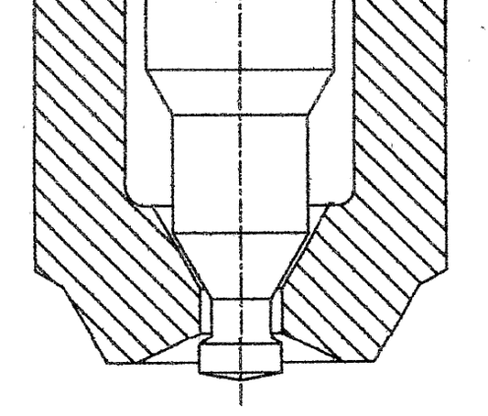
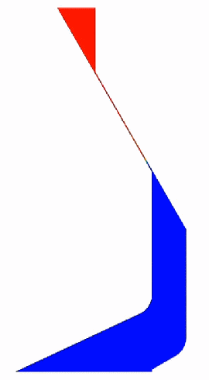
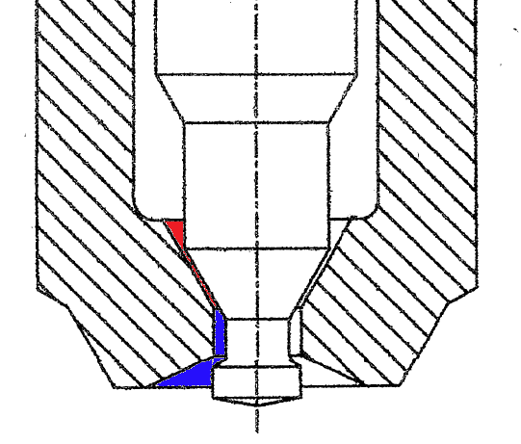
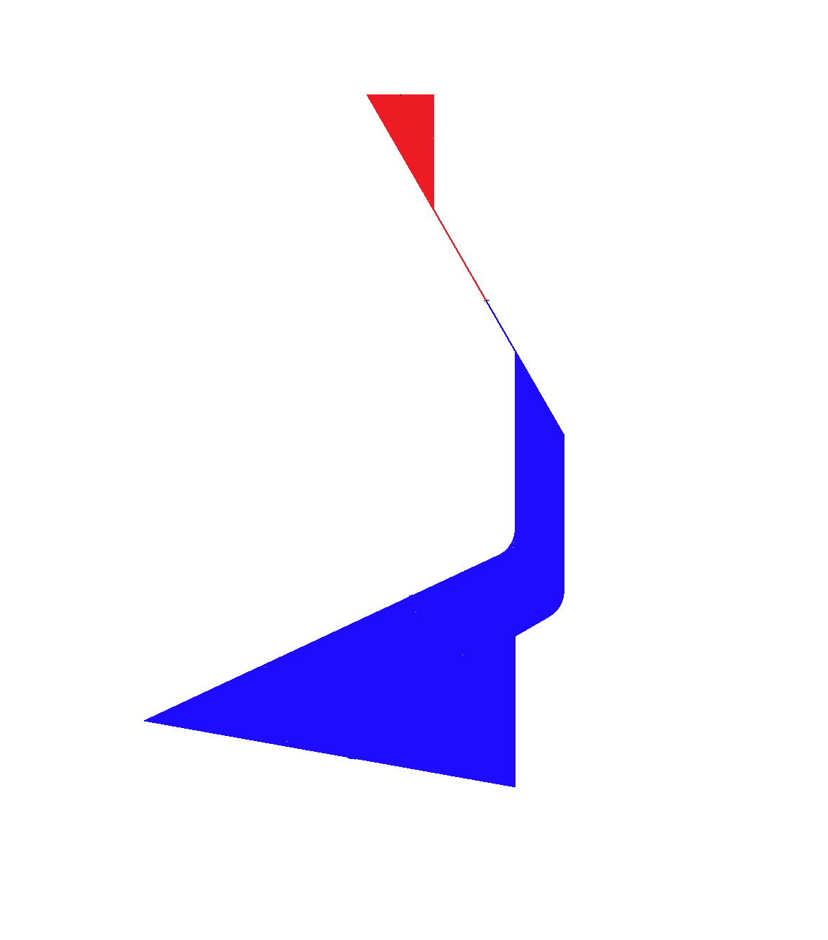
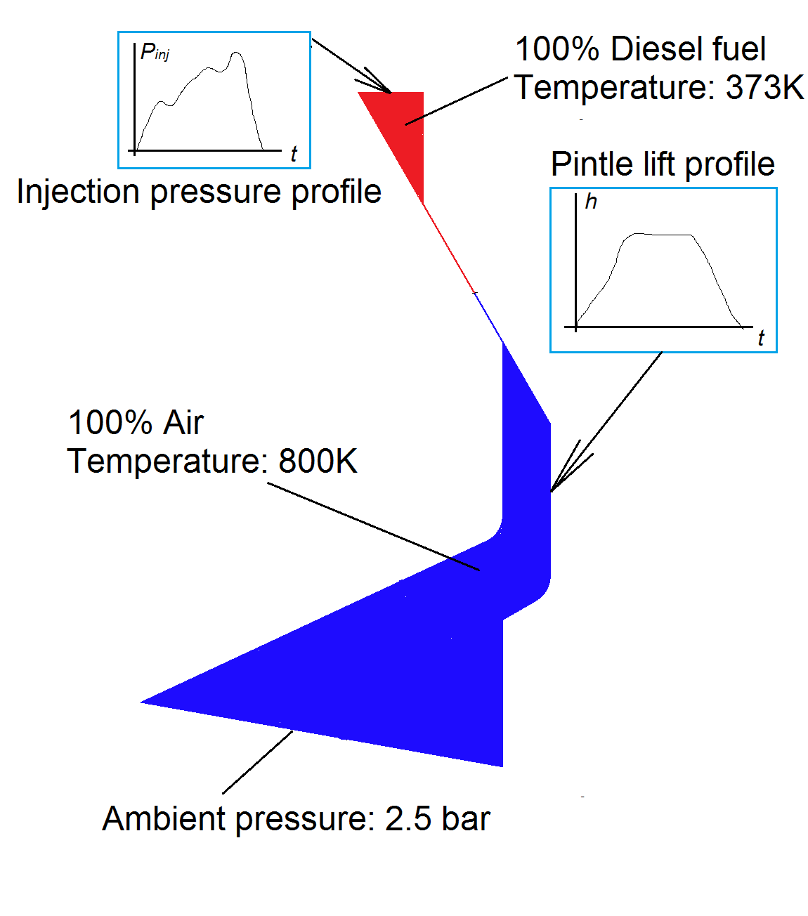
Two-stage simulation of injection
First part: internal flow
(Cavitation, Air entraining)
Second part model
Total number of cells | 20 000
Average element size | 0.3mm
Computer | Core I7-2700K@3.5GHZ
Computing time | 14 Hours / 7,5 CAD injection duration/ 4 cores employed
Models | Discrete phase/ Realizable k-e turbulence/ SSD breakup/ Convection-diffusion controlled evaporation
Boundary conditions
Simulation with
moving pintle
Pintle type injector
- Liquid
- Vapor
- Air
Export data from interface to BC of second part
Pressure, Temperature,
Turbulence, Velocity,
Mass flow rate, Blobs size
Droplet diameter 100 μm
(blobs)
First part model
Total number of cells | 250 000
Average element size | 4 μm
Computer cluster | 528 Cores X 2800GHz/ 1Tb RAM
Computing time | 24 Hours / 7,5 CAD injection duration/ 32 cores employed
Models | VOF model / Realizable k-e turbulence/ Schnerr-Sauer cavitation
- Droplet diameter 30 μm
- Droplet diameter 0.5 μm
Second part: in-cylinder region
(Breakup, Evaporation)

Slide 9
Two-stage simulation of injection
Second part: Simulation of in-cylinder
evaporating spray behavior
Second part model
Total number of cells | 20 000
Average element size | 0.3mm
Computer | Core I7-2700K@3.5GHZ
Computing time | 14 Hours / 7,5 CAD injection duration/ 4 cores employed
Models | Discrete phase/ Realizable k-e turbulence/ SSD breakup/ Convection-diffusion controlled evaporation
Adjusted parameters | Breakup time constant B=3 (handbook) Tvap= 501,4 (Vyrubov)
- Initial droplet diameter 80mm
- Droplet diameter 30mm
- Droplet diameter 0.1..10 mm
Conclusions
Fuel wets cylinder liner at full load conditions
Target of future research is search for solutions to bound spray tip penetration

Slide 10
Search for solutions to bound spray tip penetration
Dpin=2,5mm, inject. pressure 350 bar,
duration 0,22ms, m_f=0,011, Ca=0,8
Dpin=2,5mm, inject. pressure 800 bar,
duration 0,22ms, m_f=0,015, Ca=0,8
- Droplet diameter 20mm
- Droplet diameter 10mm
- Droplet diameter 1 mm
Dpin=2,5mm, inject. pressure 800 bar,
duration 0,22ms, m_f=0,011, Ca=0,5
Dpin=2,5mm, inject. pressure 800 bar,
duration 0,32ms, m_f=0,023, Ca=0,5

Slide 11
Multi-stage injection strategy
Droplet diameter
- 20mm
- 10mm
- 1 mm
Gas temperature
- 800K
- 600K
- 500К
Mass fraction of vapor
- 0.3
- 0.2
- 0
Conclusions
For HCCI operation in z-engine preferable:
from 3 to 4 stage of injections on regime of
maximum load
downsized injector geometry providing high
operation speed, high-pressure injection with
maximum area contraction (supercavitation regime
or closely to supercavitation)
earlier start of first injection (90 CAD before TDC)
lower design cone angle of pintle (about 90 deg)

